Slide 1

Health-care SUPPLY-CHAIN MANAGEMENT SYSTEM

Slide 2
Problem statement
Healthcare Supply-Chain Management System refers to the flow of medical goods from the manufacturer to the patient. Pharmaceuticals and medical equipment supply-chain lag significantly in performance compared to the other industries. In order to provide better and safer healthcare services to the patients, the healthcare providers must have a robust system to reduce medical errors. Better supply-chain processes are central to increasing patient safety. We estimate that adopting a common global data standard and upgrading supply-chain processes could slash counterfeiting in half, returning revenue to legitimate companies for reinvestment in further improvements to patient care.

Slide 3
APPROACH
To provide a common platform for hospital management to directly communicate with the legitimate manufacturers and suppliers for the purchase of drugs.
To provide a common platform for hospitals to request for any medical device across other hospitals that have the device readily available and can transport it in a timely and accurate manner.
To help hospitals keep track of their inventory. This way, hospitals can forecast the demand in the future and accordingly place an order with the suppliers and replenish their stock in a timely manner avoiding any delays.

Slide 4
Areas To FOCUS FOR ACHIEVING BEST HEALTH-CARE SUPPLY-CHAIN PRACTICES:
PHARMACY INVENTORY MANAGEMENT WITHIN THE HOSPITALS
QUALITY MANAGEMENT
USING UNIQUE ID’S TO KEEP TRACK OF DEVICES.
PROCUREMENT – PROVIDING A METHOD FOR INVENTORY TRACKING
INFORMATION SHARING & COLLABORATION- SENDING INVENTORY RELATED INFORMATION TO SUPPLIERS FOR BETTER PLANNING LIKE REQUIRED QUANTITY
INVOLVING DOCTOR IN EQUIPMENT ORDERING PROCESS
TRANSPORTATION IN HEALTH-CARE PLAYS AN IMPORTANT ROLE IN DELIVERY OF DRUGS AND MEDICAL EQUIPMENT

Slide 5
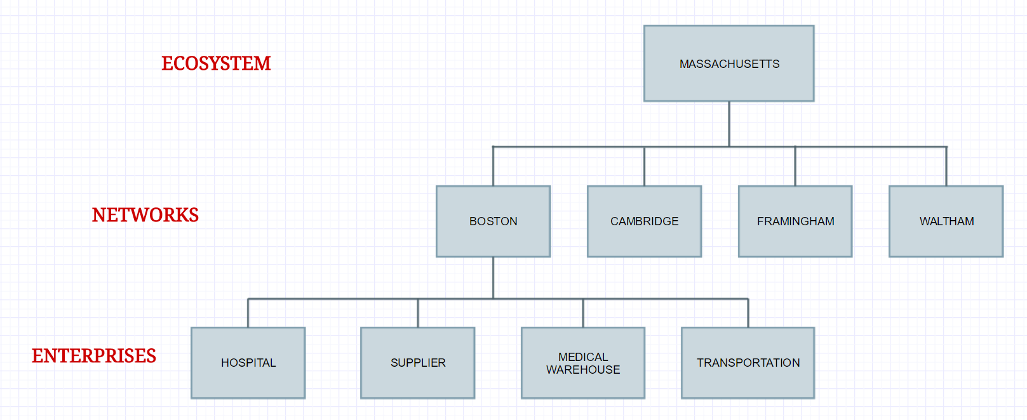
Hierarchy structure

Slide 6
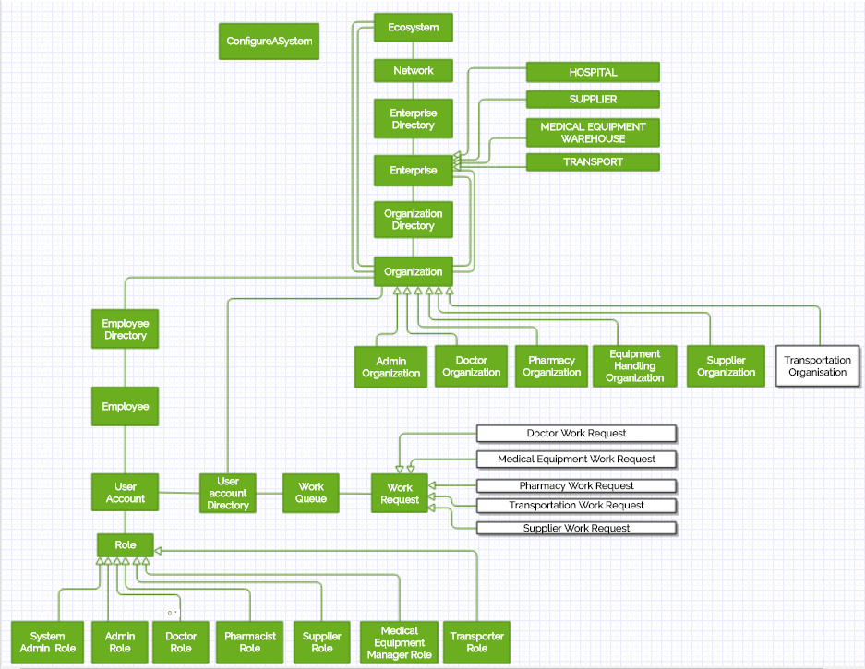
Architecture diagram

Slide 7
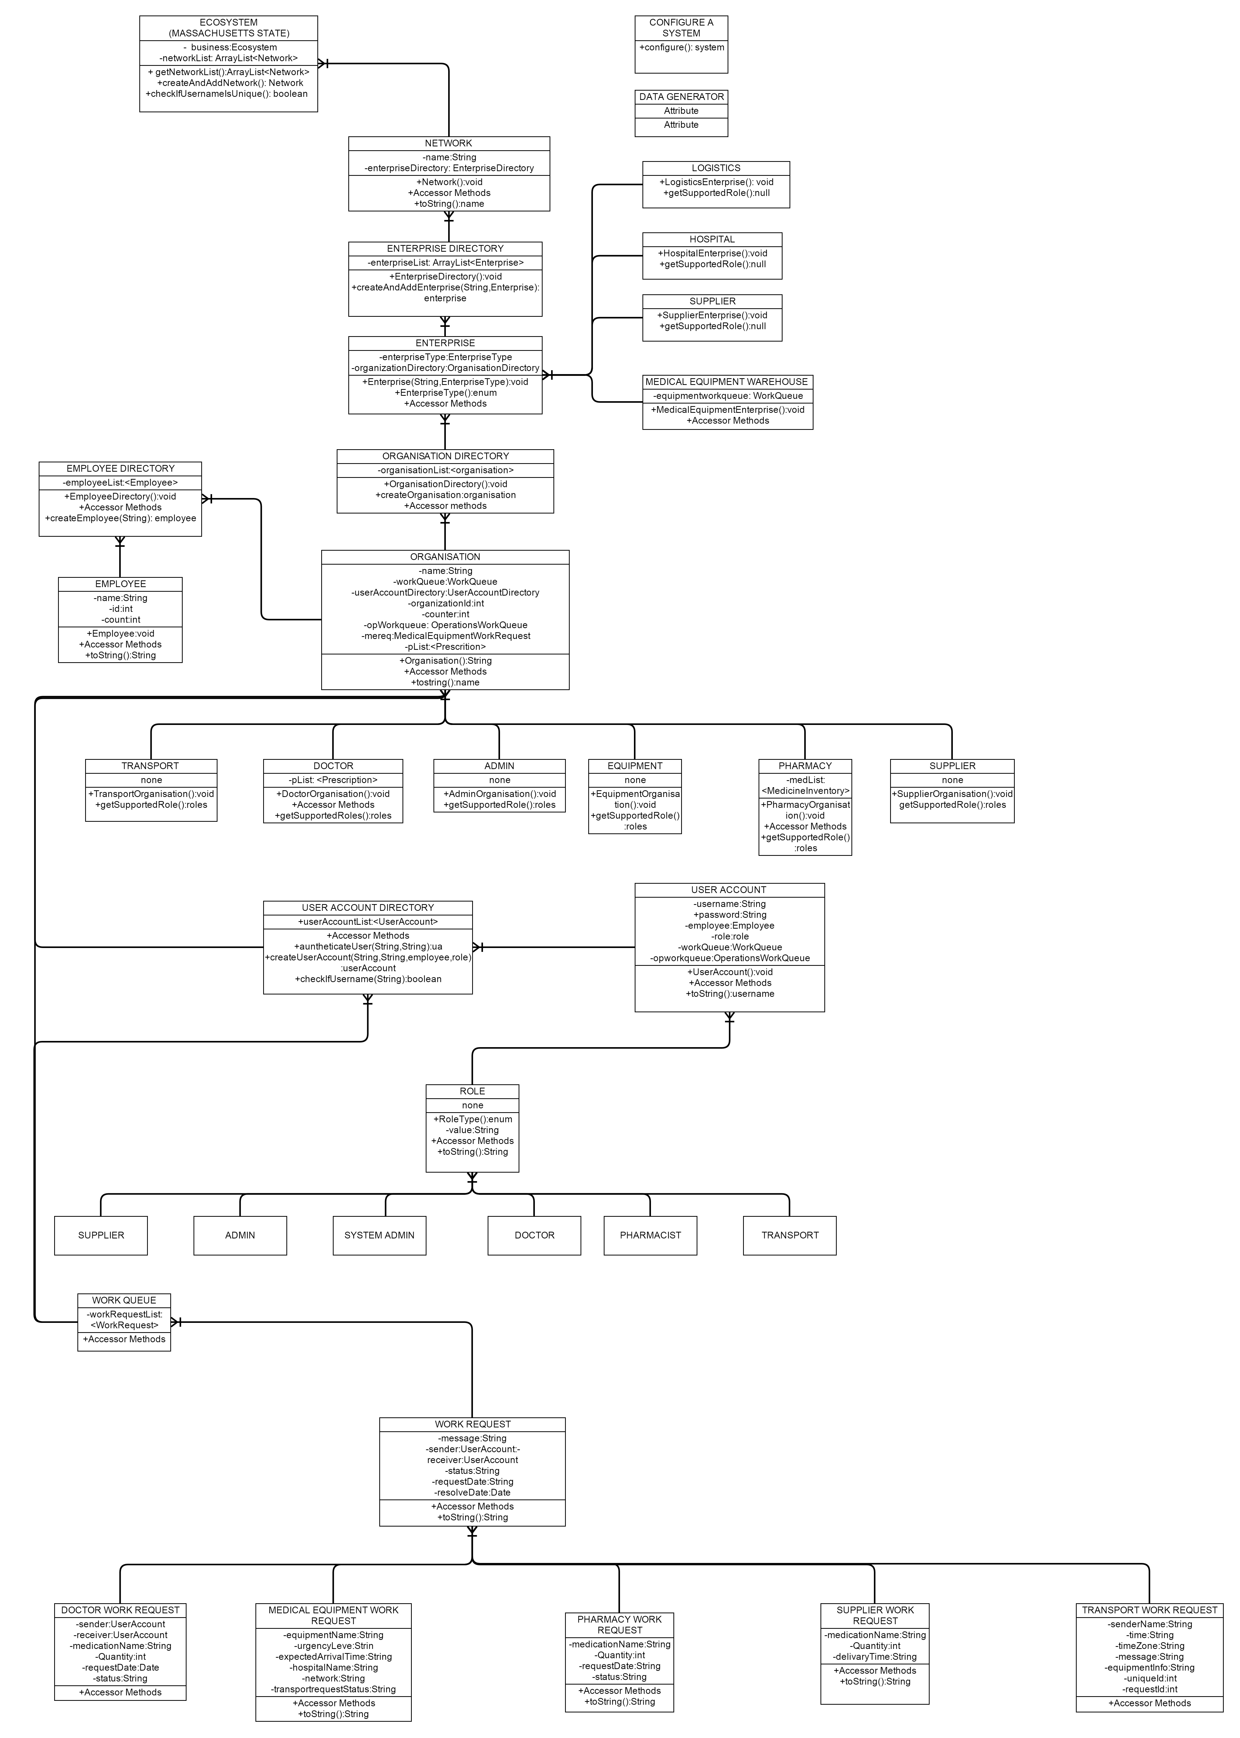
Object Model

Slide 8
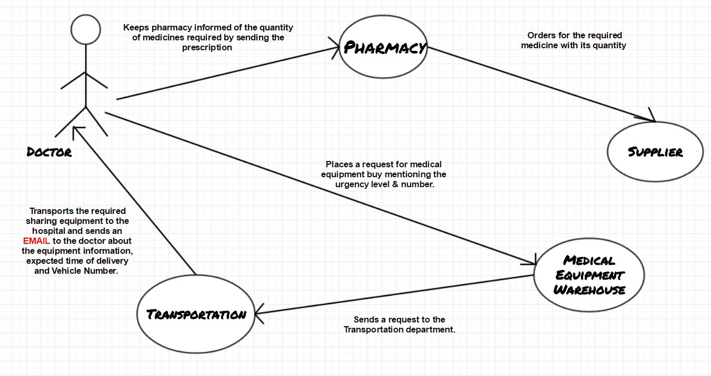
Use cases

Slide 9
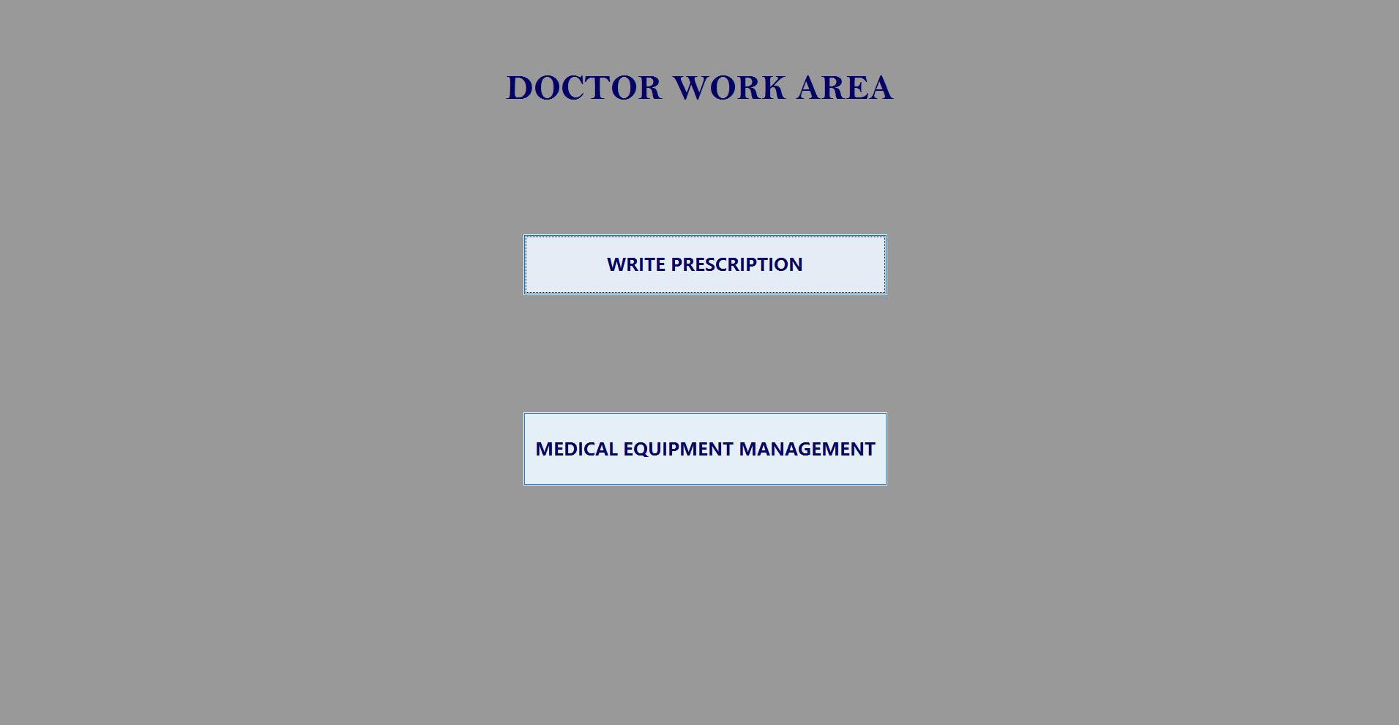

Slide 10
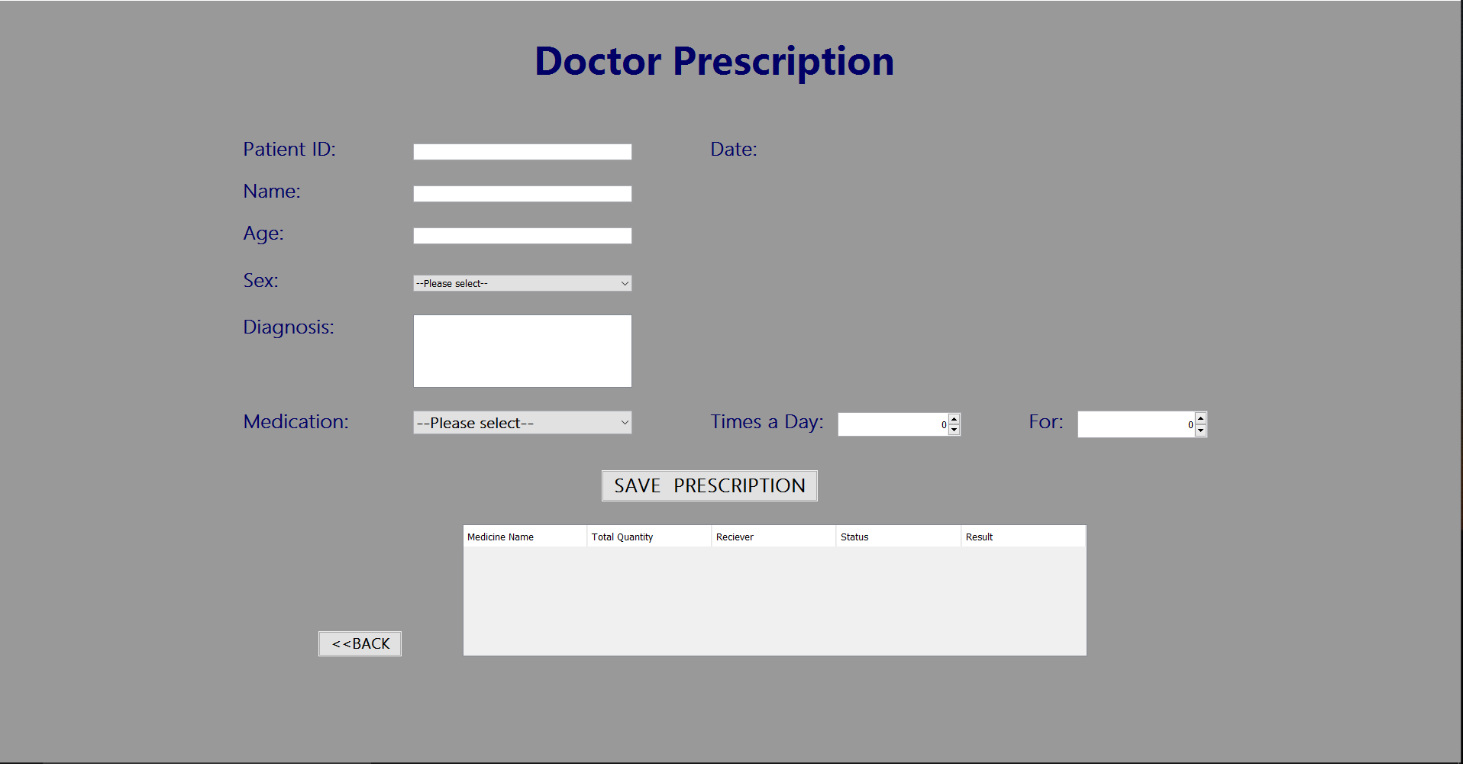

Slide 11
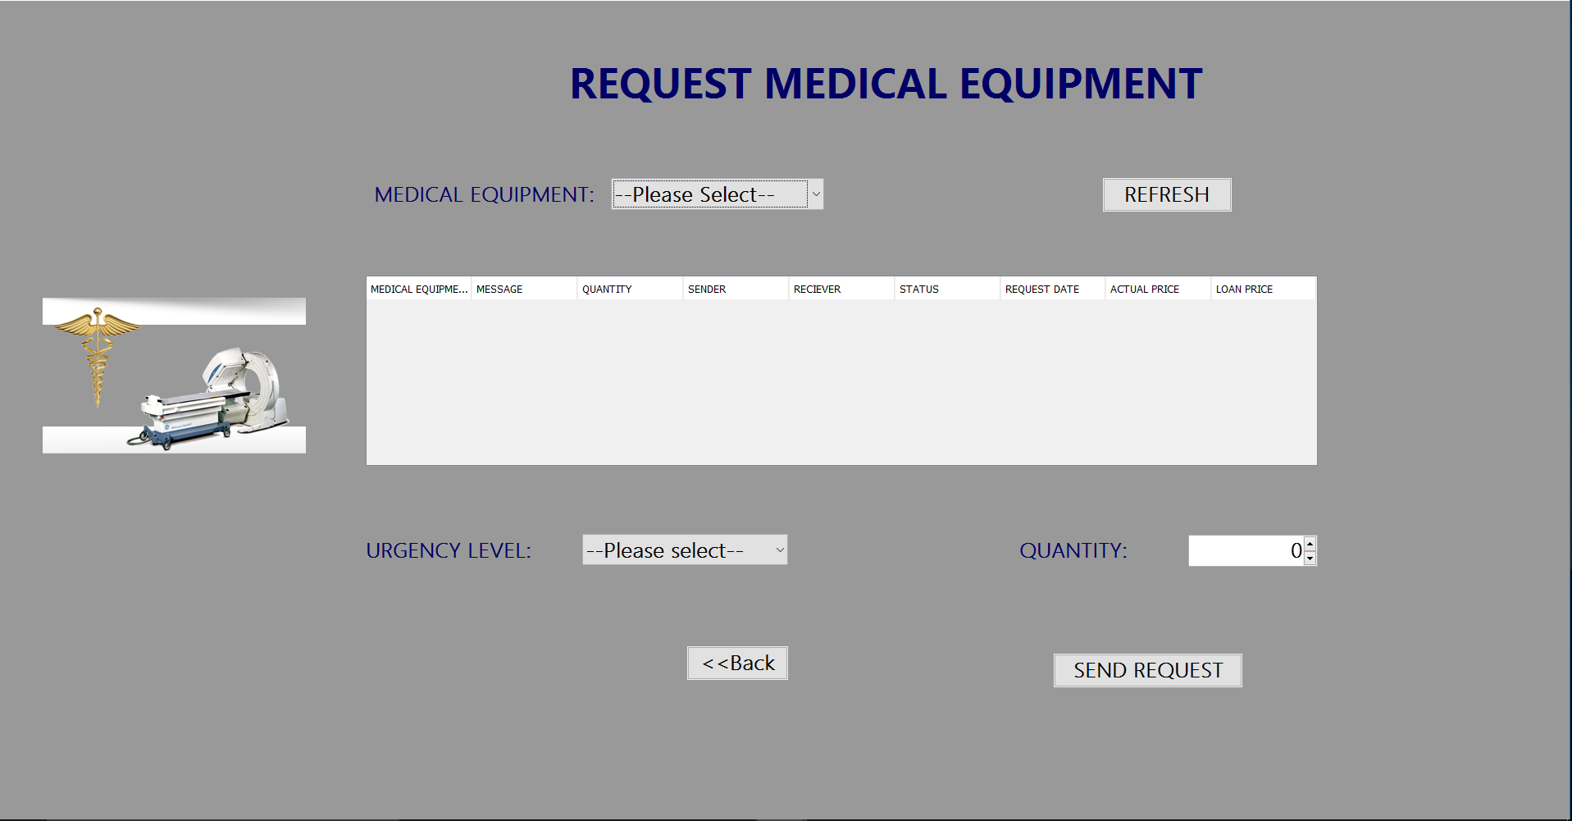

Slide 12
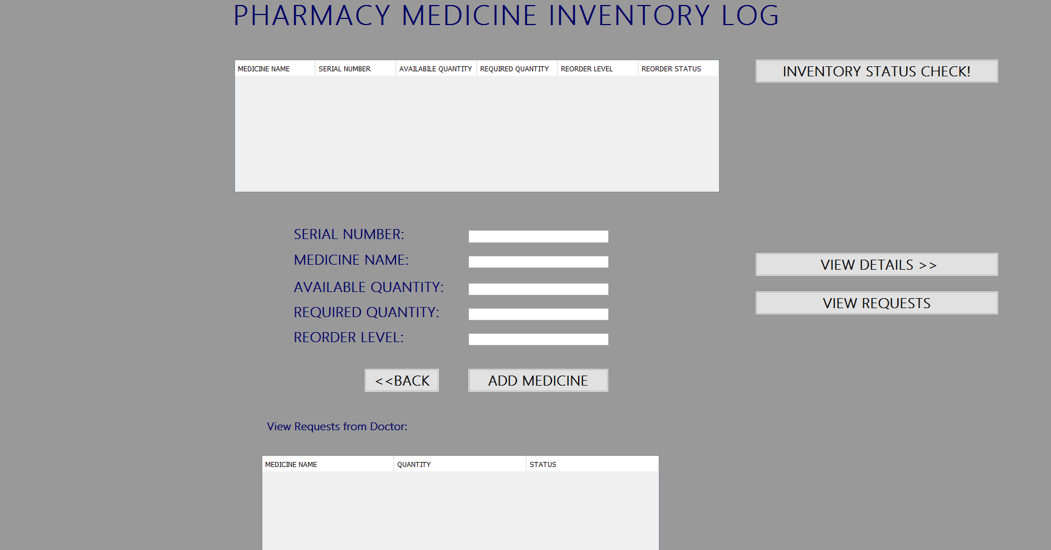

Slide 13
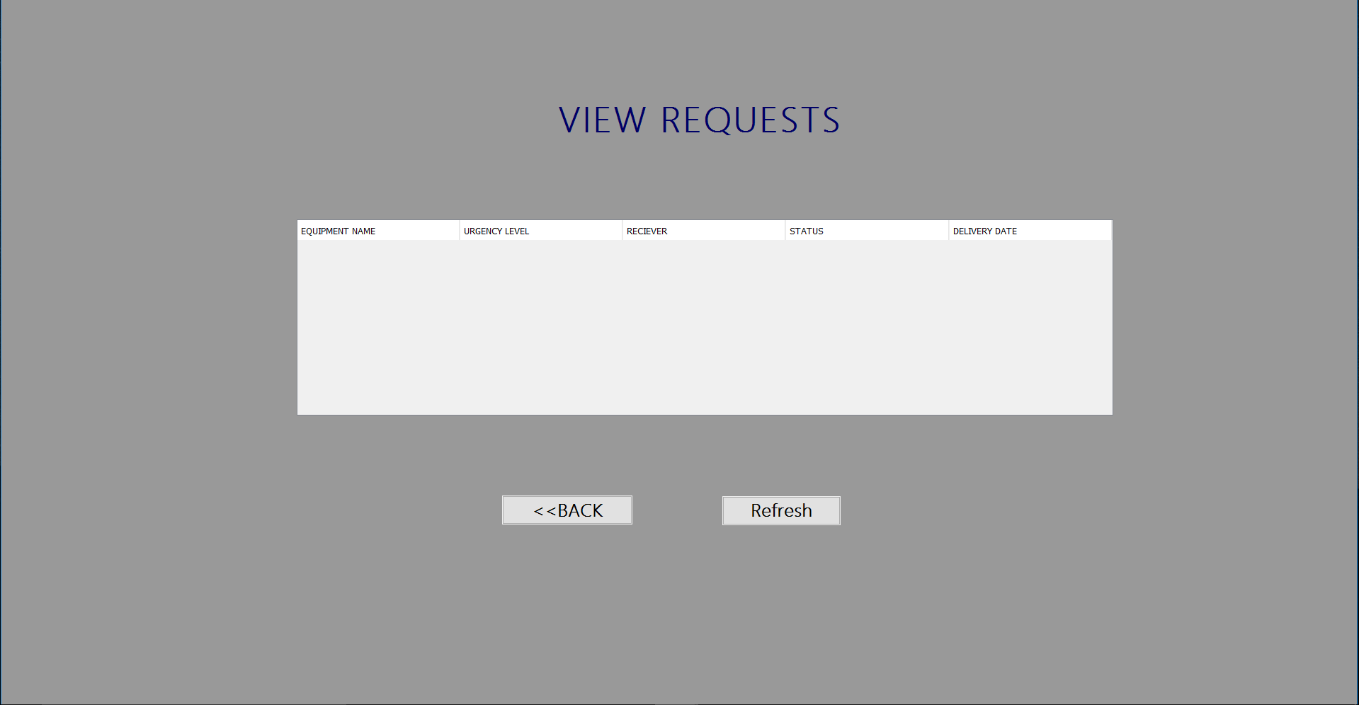

Slide 14
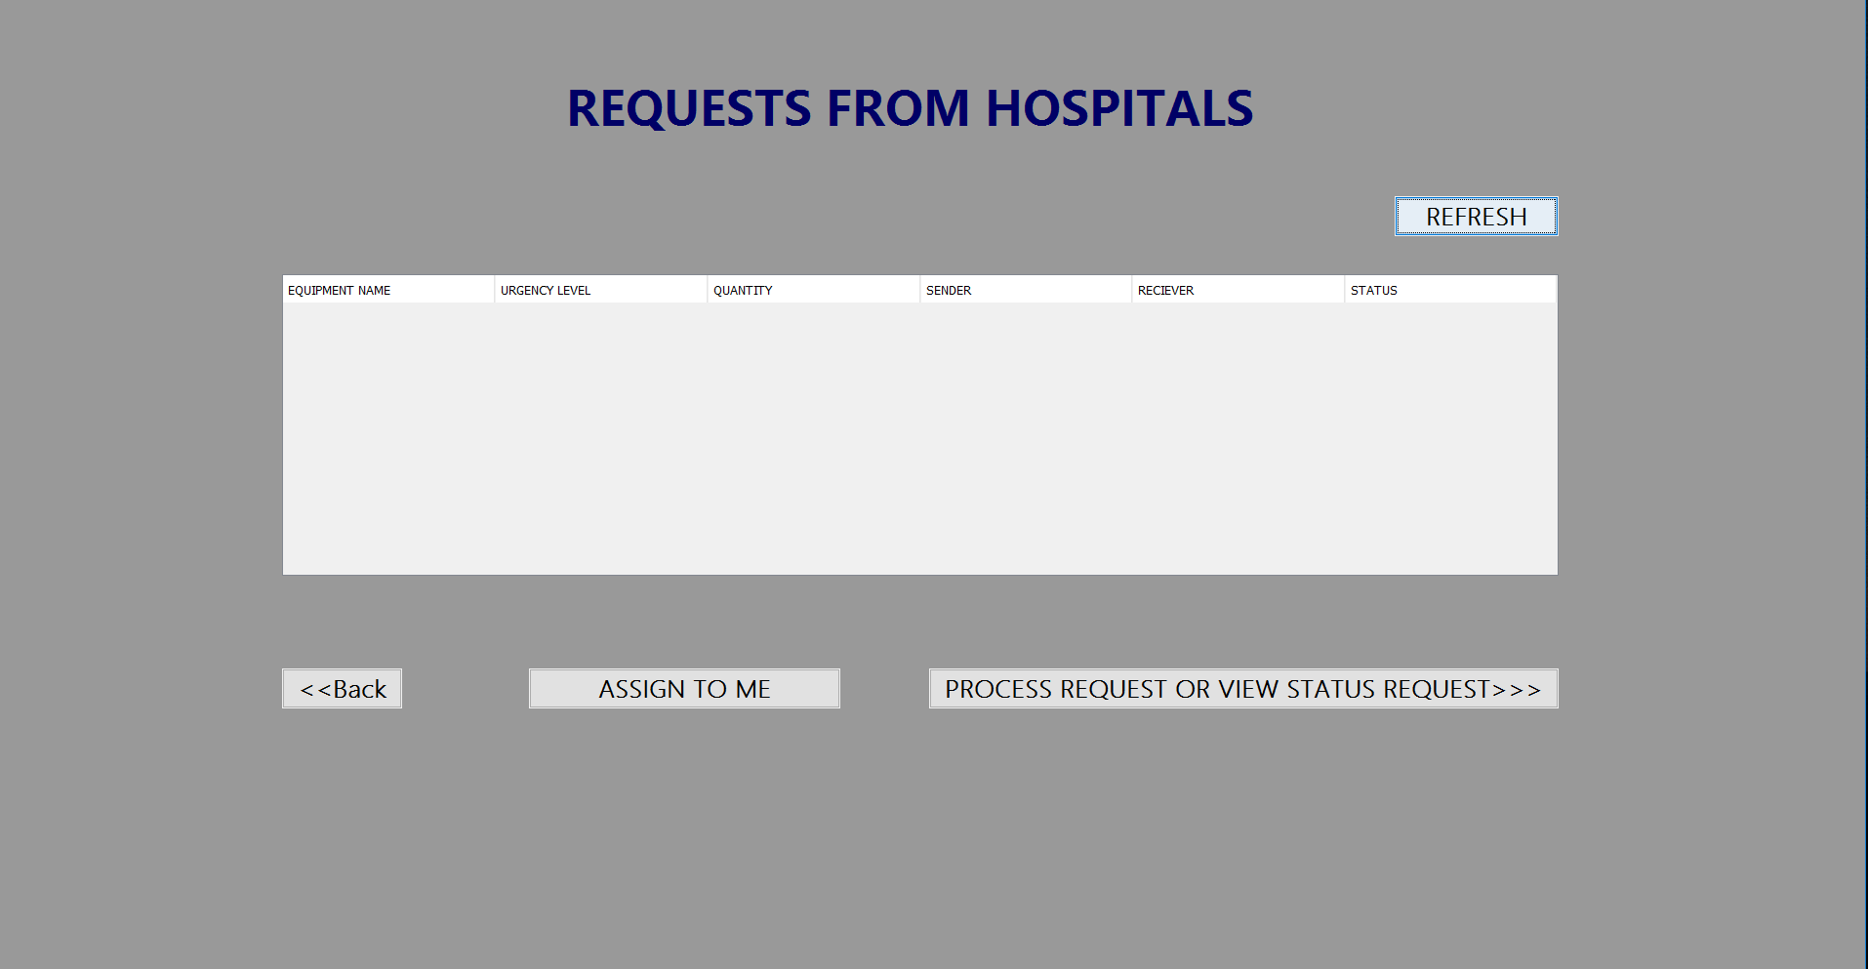

Slide 15
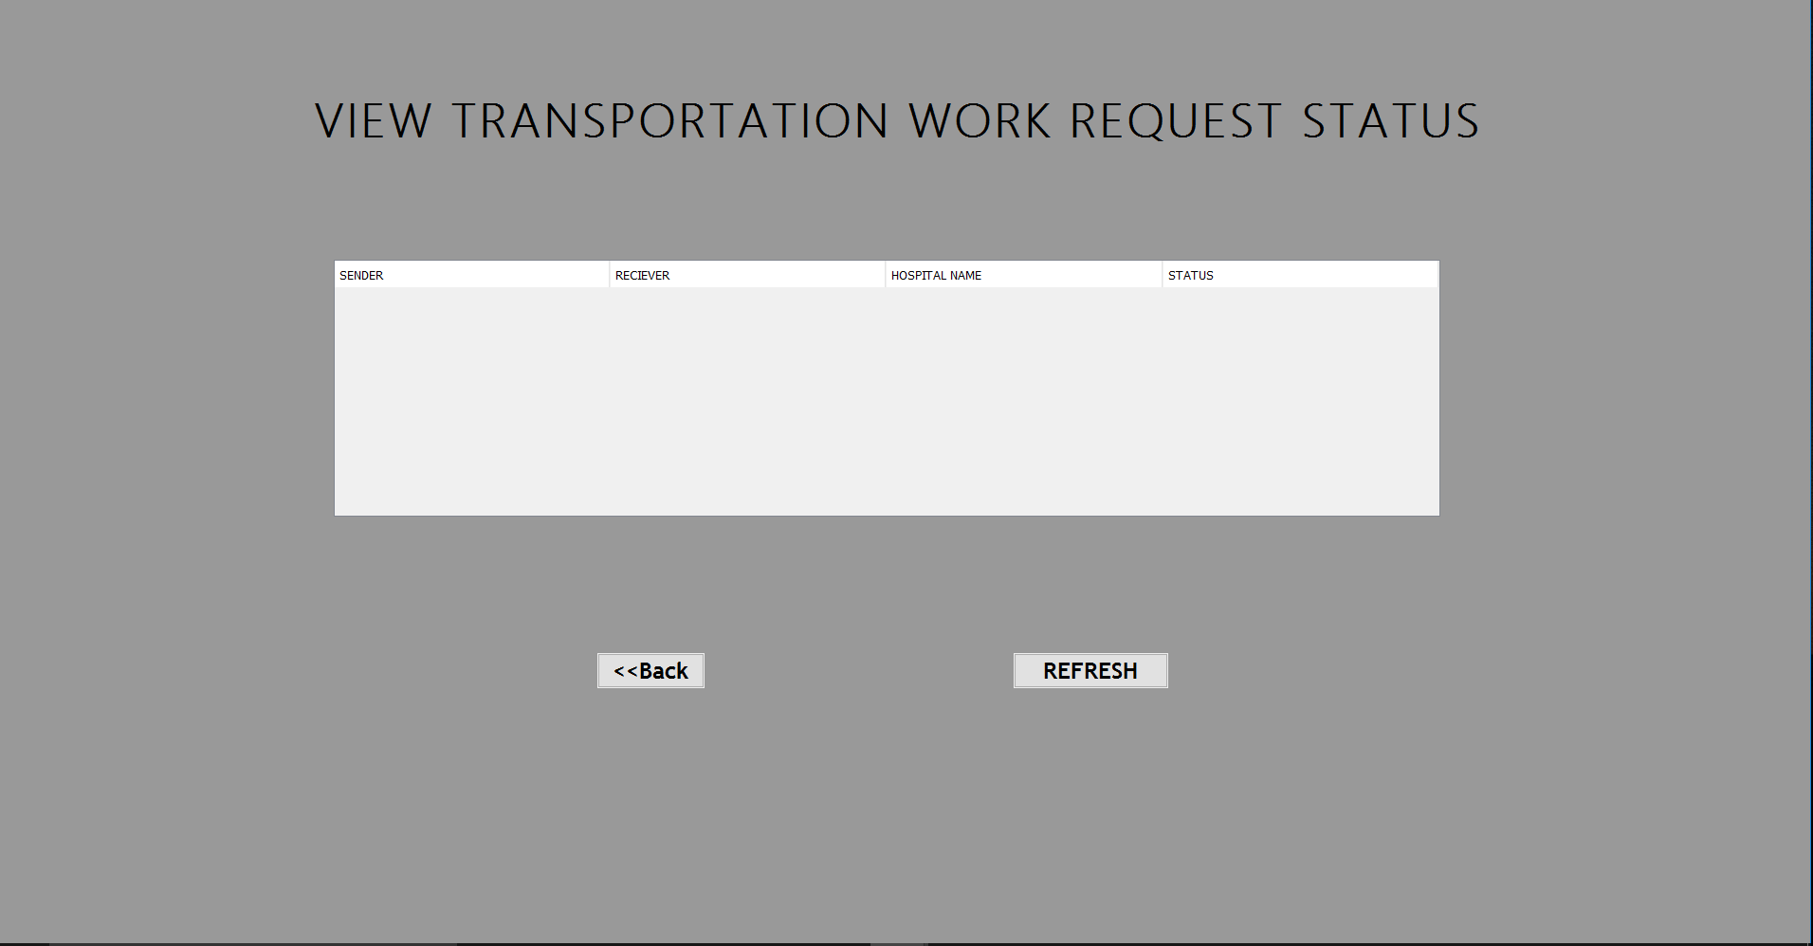

Slide 16
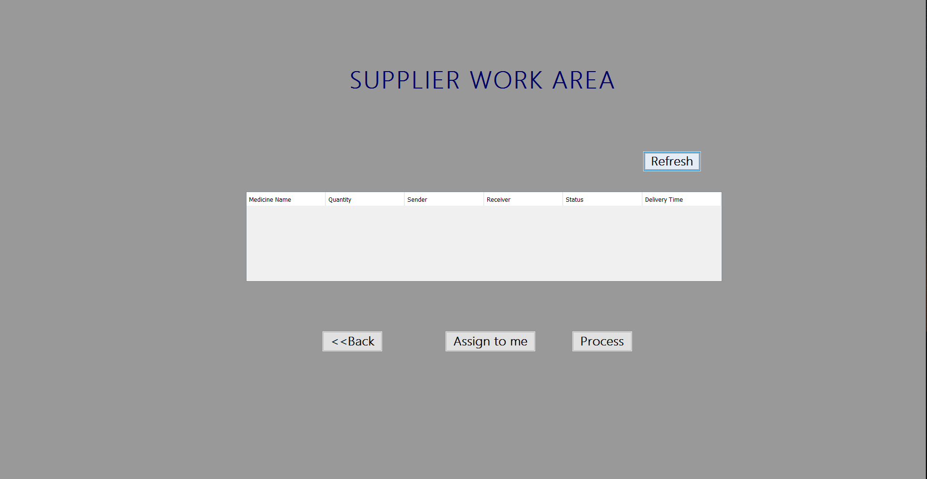

Slide 17
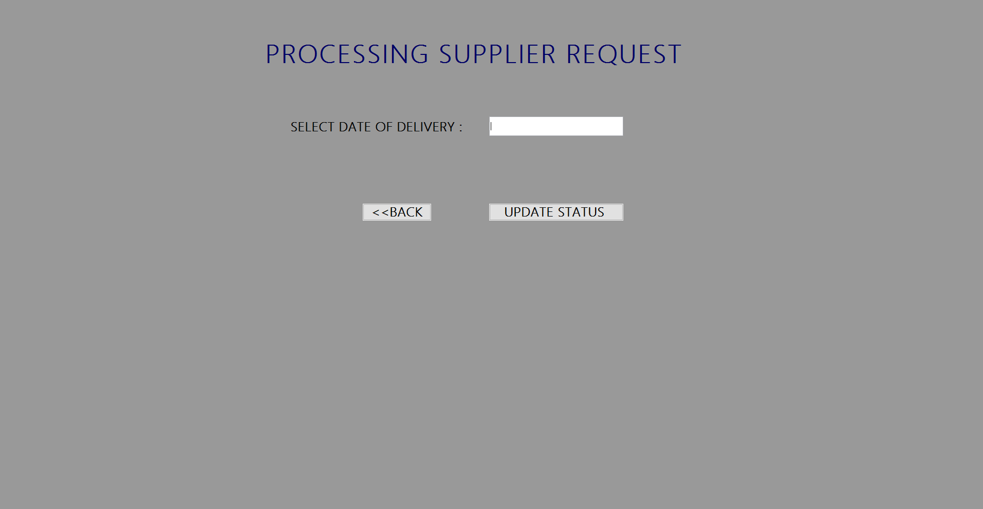

Slide 18
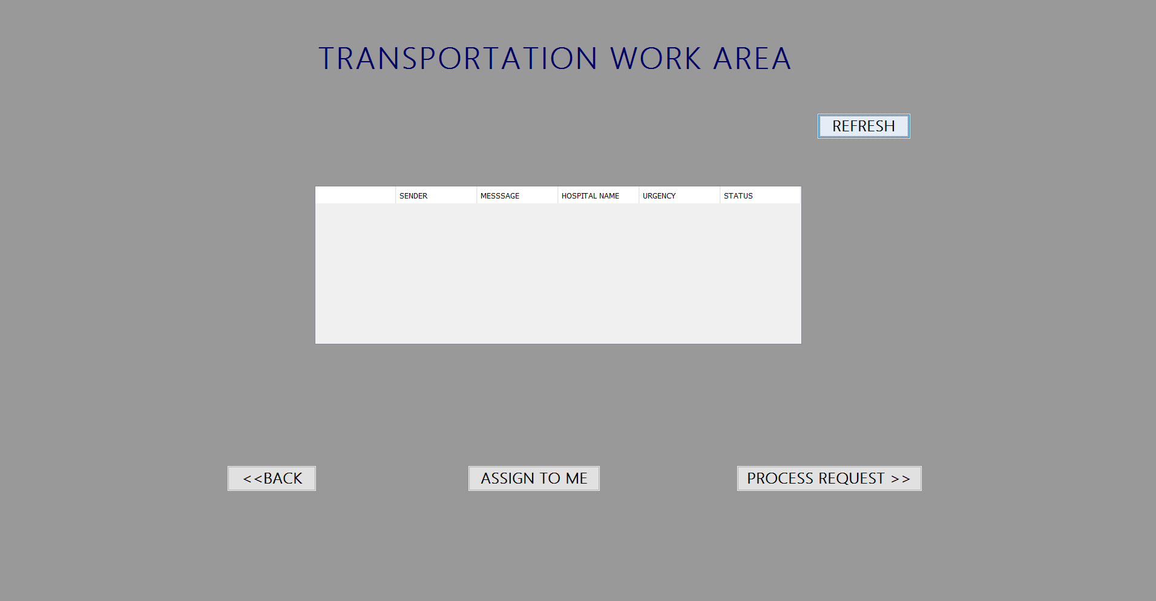

Slide 20
BENEFITS
By promoting efficiency in the healthcare supply chain, hospitals and physician practices can create substantial cost-reducing opportunities across their organization
Also, safer and cost effective healthcare can be provided to millions of patients across the country.
By adopting common global standards and upgrading the supply chain process, the companies can save huge amounts of revenue which can be reinvested in further improvements to patient care.

Slide 21
Thank you
By,
Ramya Nimmagadda
Gayathri Maganti
Reshma Konepalli

